Slide 1

GenevaERS Annual Review Transforming GenevaERS to Java
By the GenevaERS Team
December 11, 2025

Slide 2
Last Year’s OMP Presentation
z/OS Environment
We demonstrated our use of:
z/OS environment
Multi-threading
Multi-language
With JVM started only once
Primarily focused on Run-time Efficiency
Results of Efforts
Multiple levels of interfacing possible
Data transmission between applications is possible
Use of jzos is integral to success of the efforts
Although of course ASM-Java was less efficient than just ASM, the overhead was surprisingly low
Area of further research includes performance implications of ASCII to EBCDIC conversion processes for a high-performance engine like GenevaERS
Multi-Threaded Java Daemon
(Main Task)
Java Thread to start 3GL application
Java
Thread to create thread pool
Needed
Thread
Count
3GL/ASM main program
Dynamically Loaded User Written Java Classes with Methods
Subtask
Thread
Subtask
Thread
Subtask
Method
Calls
Thread

Slide 3
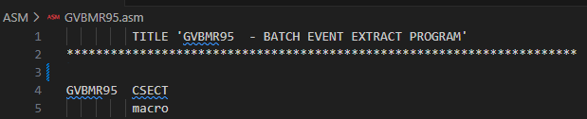
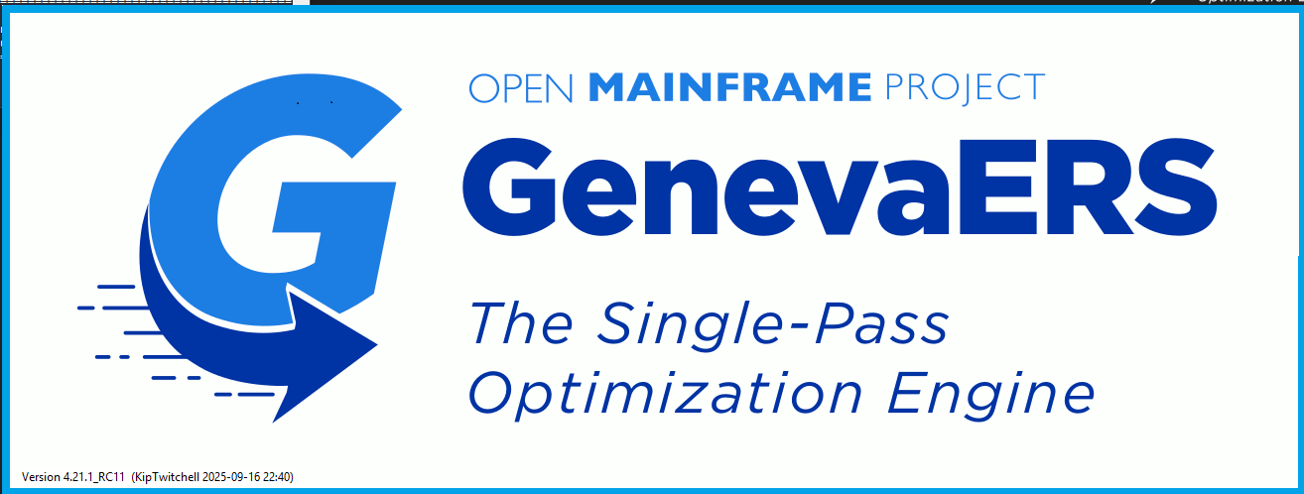
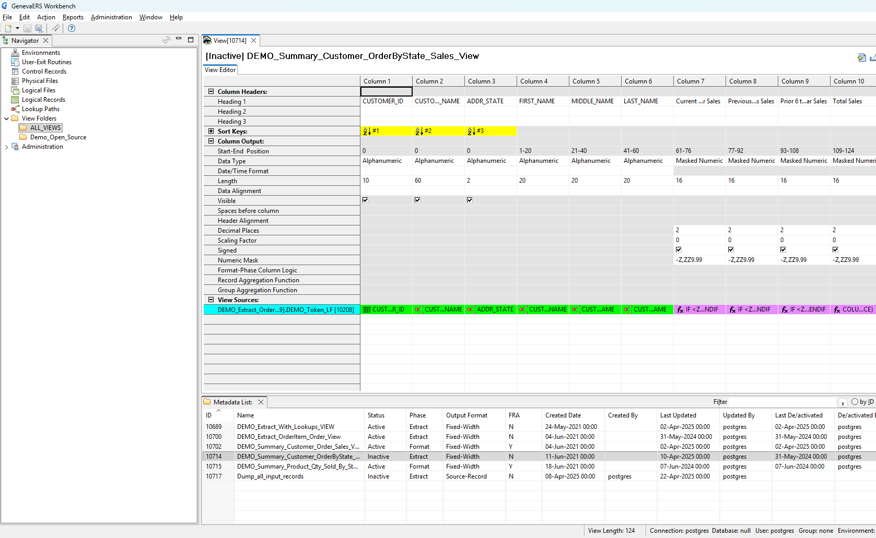
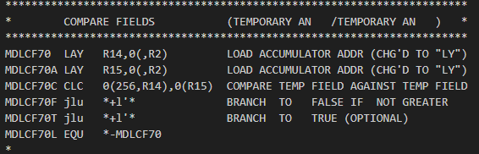
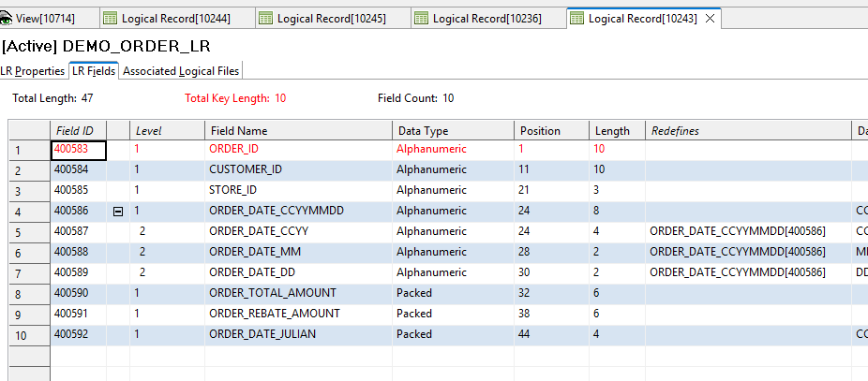
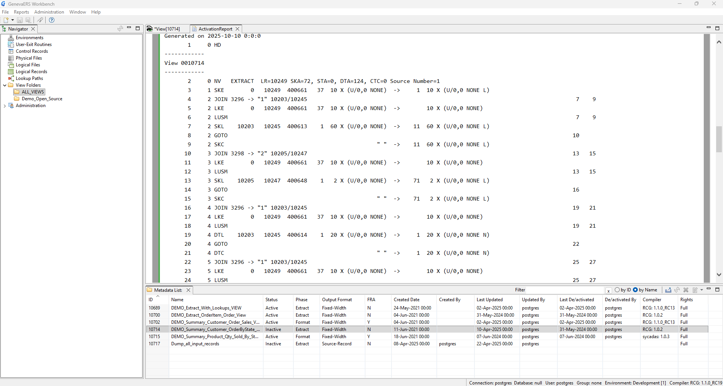
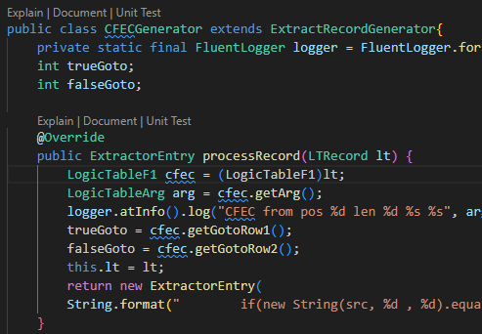
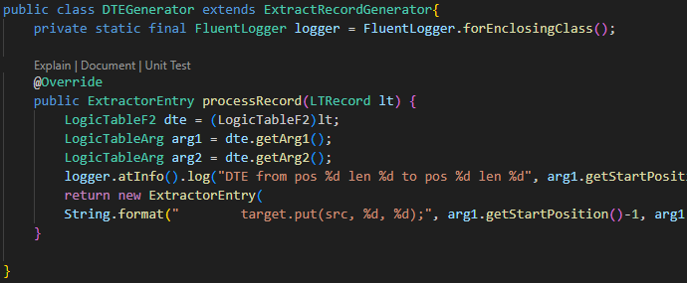
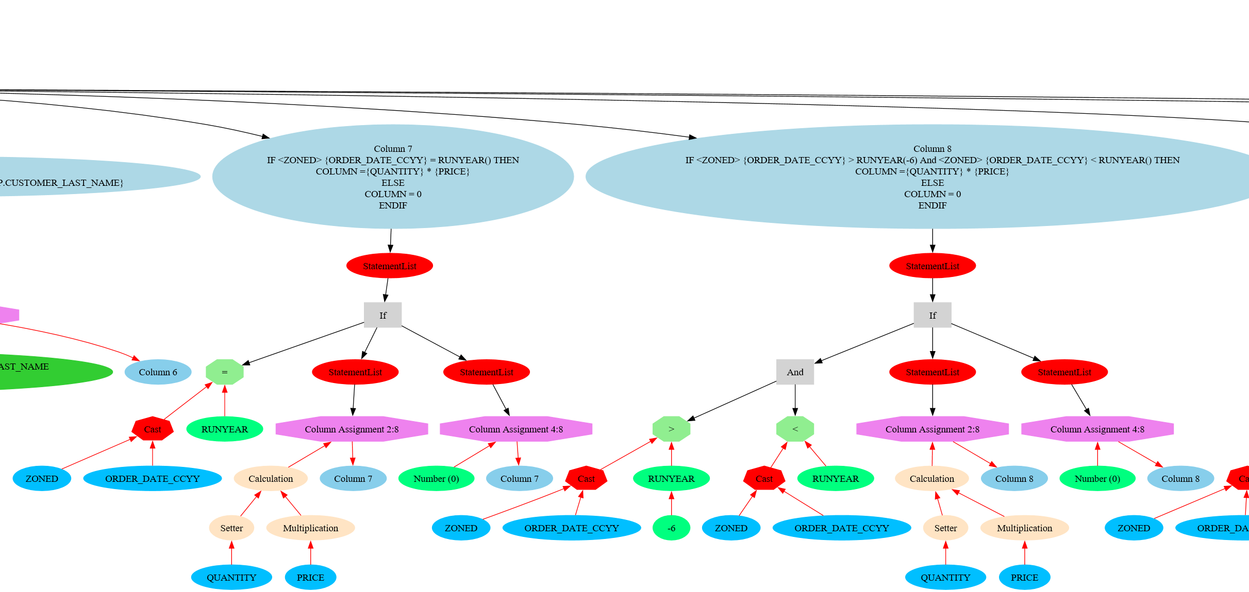
A Highly-Efficient Just-in-time Compiler
GenevaERS is a just-in-time compiler, creating highly efficient machine code for tremendous scalability for single-pass scans of data generating multiple quantitative and analytical outputs
Existing assembler code uses OP Codes to generate machine code load modules
Java Workbench
- Used to define desires processes and outputs
Logic Table
Op Code Function
HD Header
RENX Read Next
NV New View
CFEC Compare Field
DTC Data Transform
WRDT Write Data
ES End of String
EN End of Table
Assembler JIT Compiler
Input
Thread 1
Generated Machine Code Load Module
Out-put
Thread 2
Generated Machine Code Load Module
Input
Out-put
The prototype process creates Java classes that then are compiled and executed
Java Run Control Apps
- Packages specification creating a Logic Table
Java Functions
Java Compiler
Input
Thread 1
Generated Machine Code Load Module
Out-put
Thread 2
Generated Machine Code Load Module
Input
Out-put

Slide 4
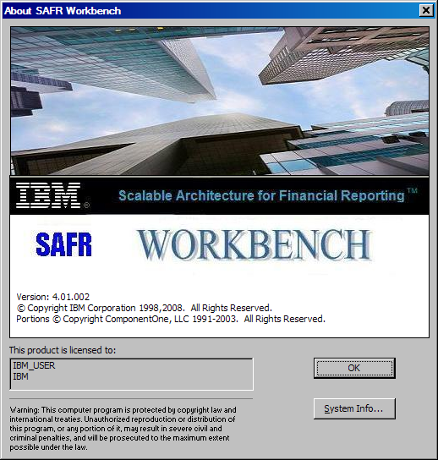
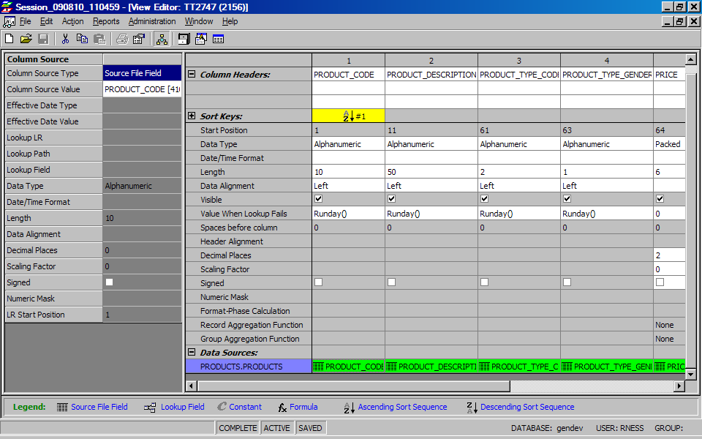
Why Java?
Contributors
Numerous open-source contributors have joined the project this year
None had access to a mainframe
They contributed to the front-end of the project, written in Java and executed locally
Java would allow them to contribute to more of the project
Platform Independence
Potential market for our project may be limited by z/OS
Our new system will work on z/OS (under java)
We may be able to run under z/Linux or other platforms
There may be some performance loss, but on z it may be mitigated by potential ZIIP usage
Other Transformation Efforts
We have explored project simplification through removal of the meta data database component
Transformation of code was deemed too difficult
Recently have prototyped a CLI for the front end workbench
May enable automation of workbench tasks, and mitigate need for the database

Slide 5
This Year’s Achievements
Fully automated build systems for all components of the project, using open source technologies
Cleared all LFX Snyk vulnerabilities in production component libraries
Cleared all user requested development tickets and in the midst of testing
Removed technical debt of C++ code replaced with java
Added enhance user reporting and graphics of process flow to user interface
Prototyped new user interface component which removes dependence on database
Prototyped a new java execution performance engine
Working on plans for GenevaERS version 5 for the next year

